Slide 1
AI-Powered Medical Doctor Category Recommendation System

Slide 2
Introduction
Title: AI-Powered Medical Doctor Category Recommendation System
Objective: To assist visitors in finding the appropriate medical doctor based on their medical records and biodata.
Features:
0.Multiple turns conversation support.
Rule-based responses for a natural conversation flow.
Visitor's biodata consideration (gender, age, smoking status).
Utilizes medical records for accurate recommendations.
Appointment scheduling and confirmation capabilities.

Slide 3
Overall system diagram
End to end system diagram, LLM, category, classification, competition--- show LLM integration,
GUI feature, background, gmap, overall diagram, system,
Live demo: recorded video, show UI, click interaction, 6 pages,
Appendix: reference;
Present: 15 min, introduction, feature, overall diagram.

Slide 4
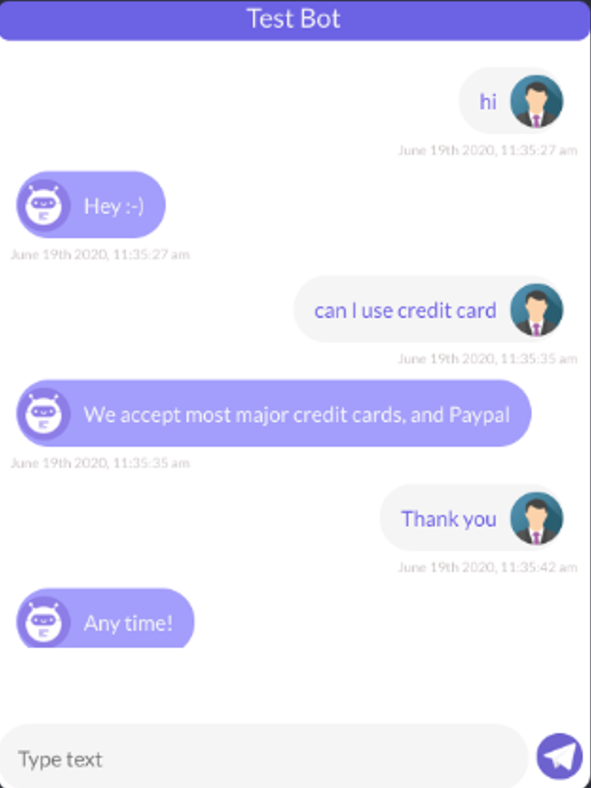
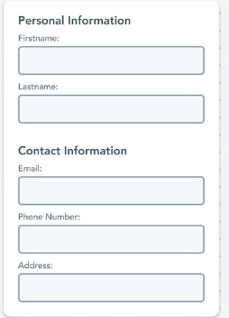
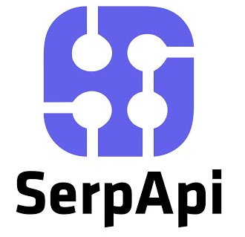
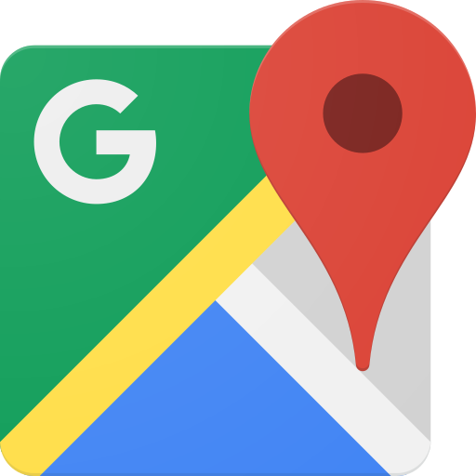





Overall System Diagram
Chat GUI
User response
MD category
Visitor’s address
Flow and rule-based logic
DB
Ask questions
Predefined questions
Symptom desc
A list of clinics
in this category with address
ID
MD records
Determine MD category
BioData
openai.ChatCompletion
sender_email
smtp_server
smtp_port
receiver_email
Initial form

Slide 5
Flow chart of the conversation
greeting
Turn by turn conversation
found category?
N
Y
appointment?
N
End
Y
Confirmation email
End

Slide 6
System Role and In-Context Learning
The system role contains recommendation logic and patient biodata, providing relevant context to the AI-agent.
In-context learning enables the AI-agent to consider the system role while using pretrained knowledge for judgment.

Slide 8
Form-Based Visitor Information Collection
The visitor is prompted to fill out a form providing the following information:
0. Name
Gender
Age
Smoking Status (Yes/No)
Medical History/Records
Address
Contact Details

Slide 9
Greeting and Initial Conversation
AI agent greets the visitor and acknowledges the form submission.
Asks, "What brings you here today? How can I assist you?"

Slide 10
Turn-by-Turn Conversation
The AI-agent and user engage in a turn-by-turn conversation.
The AI-agent uses in-context learning to refer to the system role for recommendation logic.
The pretrained knowledge helps in providing well-informed responses.

Slide 11
AI-Powered Recommendation Process
The AI agent processes the visitor's information, including biodata, symptoms, and medical records.
Applies Open AI LLM to match the individual with the most suitable medical doctor category.
The AI agent explains the recommendation based on the collected data.

Slide 12
Brief descript for the AI-Assistant
Built on the Open AI Chat completion.
With in-context learn, the context is some logics for recommending the MD category. The bot will take the context as reference, but the bot still use pretrained knowledge to make the judgement.
The roles are set up: system role contain some recommendation logic, and the patient’s biodata.
Then the conversation will be turn by turn between AI-agent and the user.

Slide 13
Appointment Scheduling
The AI agent asks, "Would you like to make an appointment with the recommended doctor?"
If the visitor agrees, the AI agent schedules the appointment with the recommended doctor type given the provided address and preferred time the visitor select from the calendar.

Slide 14
Confirmation Email
After the appointment is scheduled, the AI agent sends a confirmation email to the visitor's provided email address.
The email includes appointment details, time and location, and a summary of the recommended medical doctor category.

Slide 15
Conclusion
The AI-Powered Medical Doctor Category Recommendation System offers a seamless and personalized approach to help visitors find the right medical doctor.
Employs in-context learning to make contextually relevant recommendations.
Simplifies the appointment booking process and enhances the overall healthcare experience.

Slide 16
Future works
Suggestions

